Slide 1
Selecting new cultivars for a resilient industry
Andréanne Hébert-Haché and Caroline Provost
GCGN webinar series
May 25th 2023

Slide 2
Overview
Climate changes in the Quebec vineyards
Context of the upcoming research project
Decision-making process
New cultivar selection criteria
Data collection and timelines

Slide 3
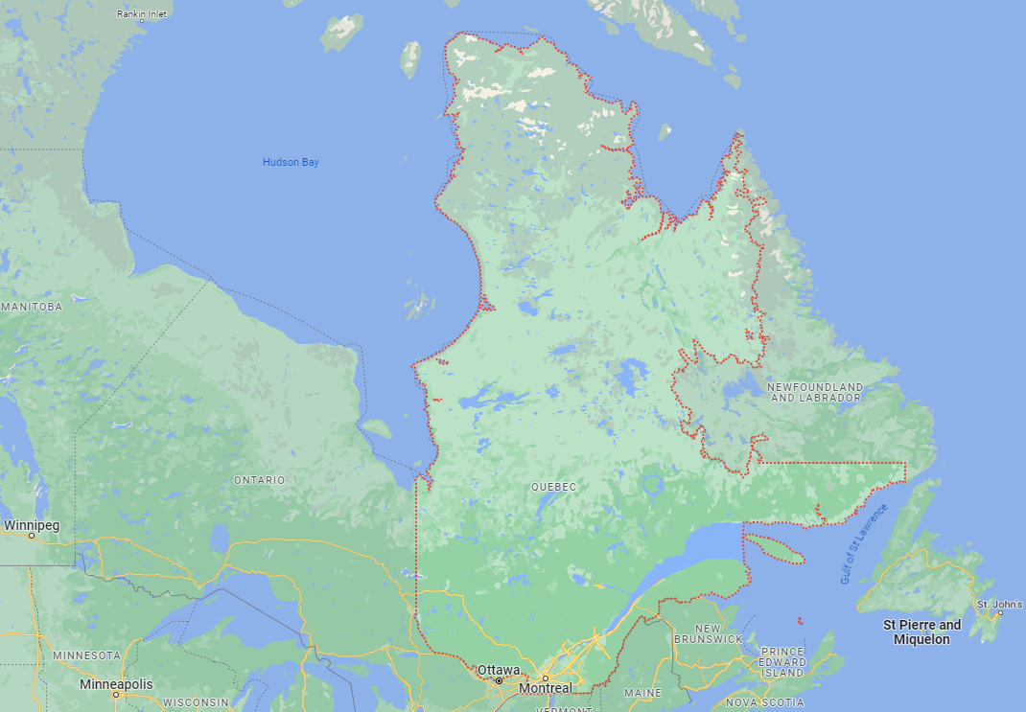
Quebec grapegrowing regions

Slide 4
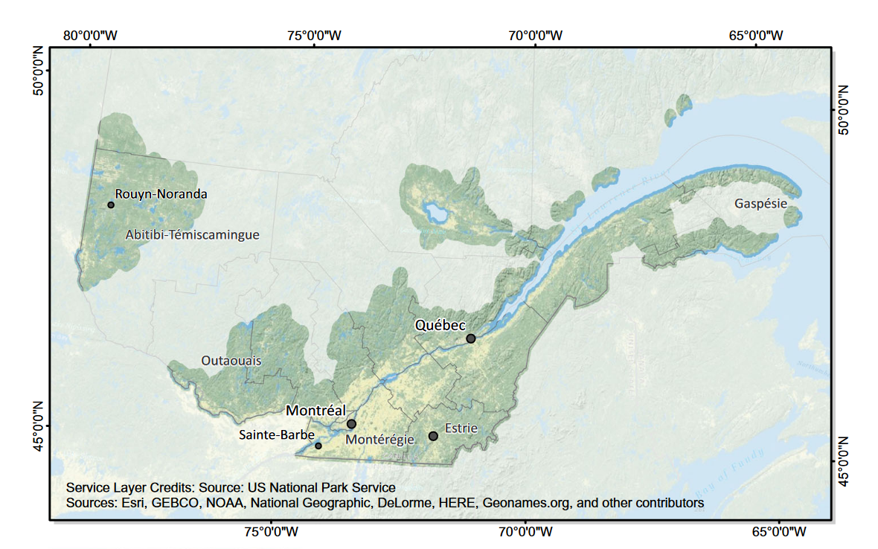
Quebec grapegrowing regions
Roy et al. 2017

Slide 5
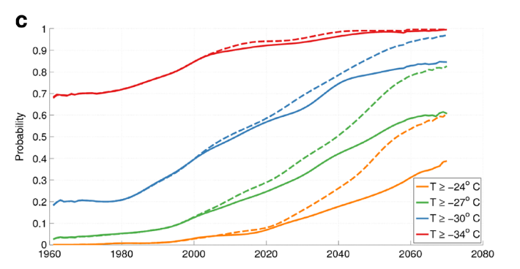
Climate changes in Quebec
1 or 2 out of 10 winters will still have minimum temperatures below -30 °C by 2070
Towards more extreme weather patterns
More GDD and frost-free days
Higher minimum winter temperatures and fewer occurrences of extreme cold events
  But still present
Stable chances of spring frost
  6 nights of frost this year (so far!!)
Roy et al. 2017

Slide 6
Context of the research project
Two concurrent projects:
  MAPAQ cultivar trial study (initiated summer 2022)
  CAPS viticulture and oenology cluster (tbd)
Framework of the project is the MAPAQ mandate for all cultivar trial studies within the horticultural sector
  Identify cultivar adapted to our climatic conditions
  Improve climate change resiliency
  Reduce pesticide usage
  Controlled experiment with scientific supervision
  Publicly available results

Slide 7
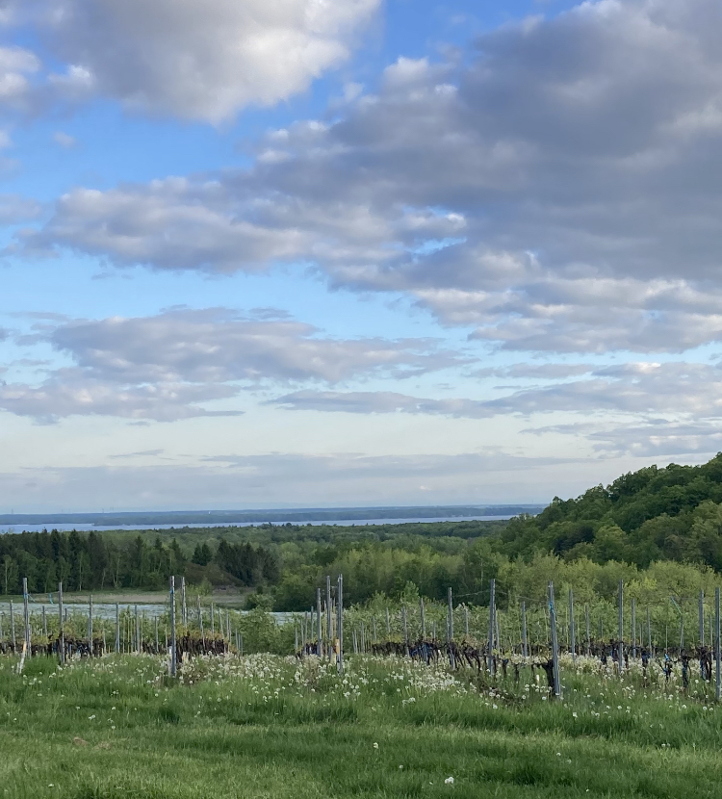
Context of the research project
Specific objectives:
  Characterize the growth of new cultivars within the Quebec terroir
  Quantify/characterize…
    The phytosanitary interventions required
    Cold hardiness
    Preliminary yield assessment
  Determine the oenological potential of the new cultivars
Multi-step process
  Level 1: planting at experimental research vineyard and data collection (2023-2027)
  Level 2: commercial vineyard planting (2027 - …)
Notes:
Activity 1: New grape varieties to control diseases and increase wine production in eastern Canadian vineyards.
The main objective is to evaluate and optimize the potential of new and existing grape varieties under the growing conditions of Eastern Canada to increase wine production in Canadian vineyards. The specific objectives are:
Characterize the potential of new hardy and/or disease resistant grape varieties to limit phytosanitary interventions, increase yields and increase the quality and diversity of wines produced in Eastern Canadian vineyards.
Identify new varieties that require significantly fewer sprays and are suitable for Canadian north-eastern provinces climate and produce high quality fruit.

Slide 8
Decision-making process
Committee assembled to supervise the trials with representatives from…
  CRAM
  Grape growers
  Conseil des vins du Québec representatives
  Agronomists and oenology consultant
  MAPAQ
Meetings held at each key steps of the process and when decisions need to be made
Decisions made by majority vote

Slide 9
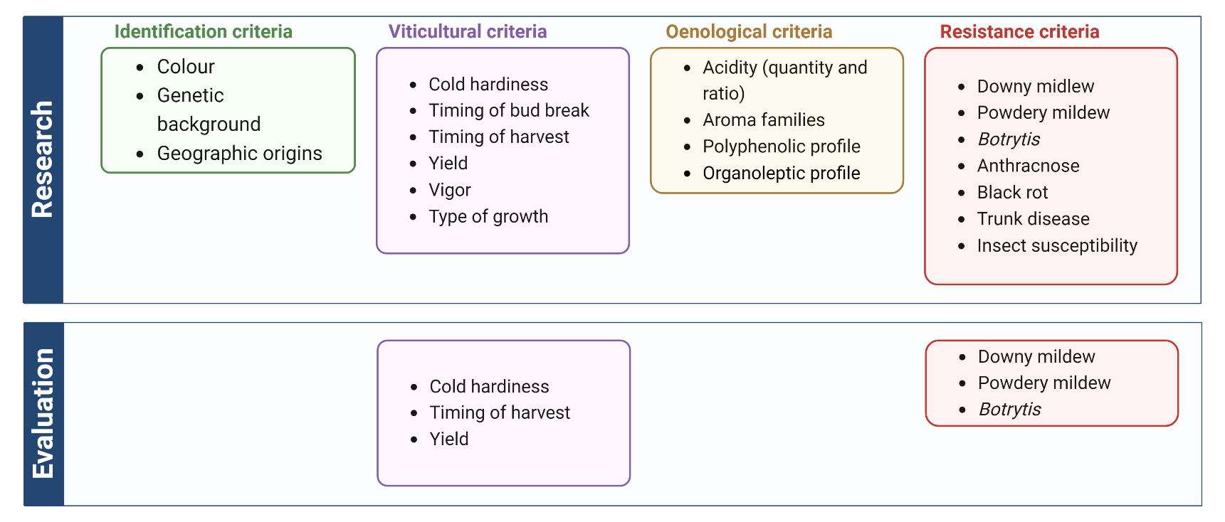
New cultivar selection criteria

Slide 10
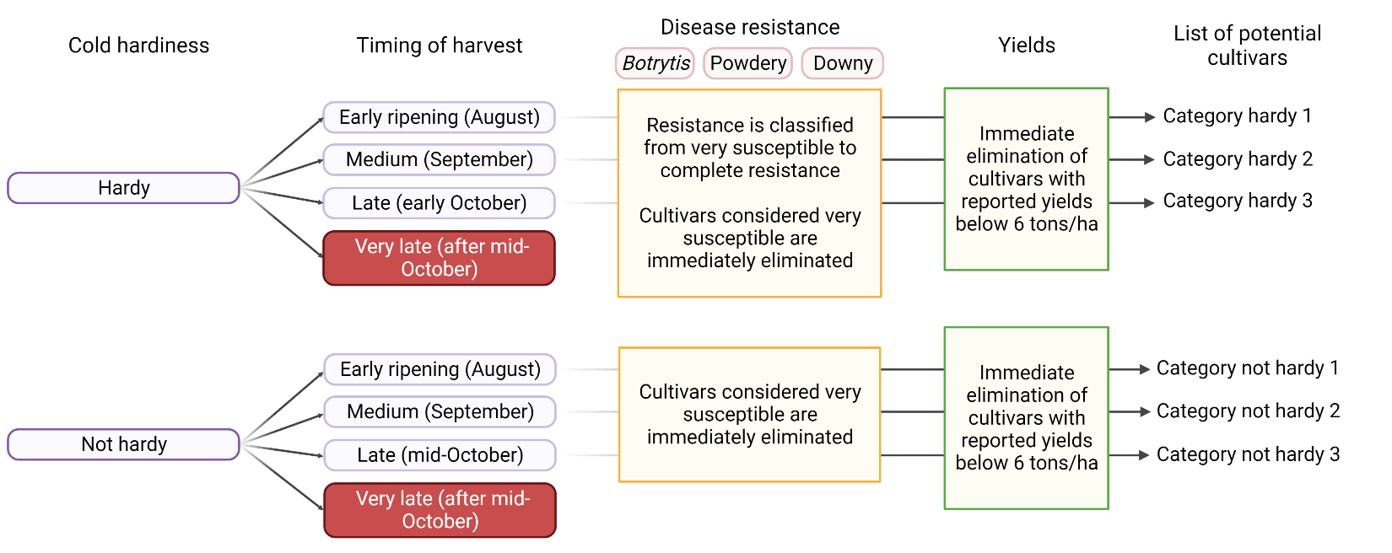
New cultivar selection criteria

Slide 11
Survey results – hardy cultivars
Planting 2023
Évangeline (KW96-2)
MAVO 98-97-02
Chenibec
Itasca
MAVO 02-05-01
Fleurtai (2024)
Clarion (2024)
Planting 2025
Rondo

Slide 12
Survey results – not hardy, early ripening
Planting 2023
Solaris
Bacchus blanc

Slide 13
Survey results – not hardy, midseason
Plantation 2023
Helios
Plantation 2025
Villaris
Pinotin

Slide 14
Survey results – not hardy, late ripening
Planting 2023
Noiret
Johanniter
Planting 2025
tbd

Slide 15
Summary planting 2023
Hardy
Évangeline (KW96-2)
MAVO 98-97-02
Chenibec
Itasca
MAVO 02-05-01
Fleurtai (2024)
Clarion (2024)
Tender early
Solaris
Bacchus blanc
Tender mid-
Helios
Tender late
Noiret
Johanniter
Additional cultivars
TP 01-01-12
ES 10-18-14
Regent
Reference cultivars
Vidal
Marquette

Slide 16
Experimental design
Randomized complete block design
  10 vines per cultivar, repeated 4 times + 10 vines unprotected
  1.22 m (vine) x 2.44 m (row) spacing
  Covered by geotextile
  Replicated small-batch winemaking trials
Preliminary virus testing before implantation or ASAP
  Accute vector scouting/control

Slide 17
Data to be collected
Viticulture:
Phenological development
Pest susceptibility
Nutrient deficiency
Periderm formation
Vine growth/pruning weights
Yields
Oenology:
Pre-harvest monitoring
Berry chemistry
Must parameters
Fermentation monitoring
Final wine parameters
  With/without MLF
Wine aging
Sensory evaluation:
Descriptive analysis
Grape and wine community tastings

Slide 18
Timelines
2022-2023 | 2024 | 2025 | 2026 | 2027
Land preparation Cultivar selection Vine import/quarantine (if required) Planting Initial data collection on vine implentation | Planting missing cultivar Viticulture data collection | Viticulture data collection Initial oenology data collection Very small batch winemaking | Viticulture data collection First « real » harvest Winemaking Oenology data collection Initial sensory data collection | Sensory data collection Viticulture data collection Winemaking Oenology data collection

Slide 19
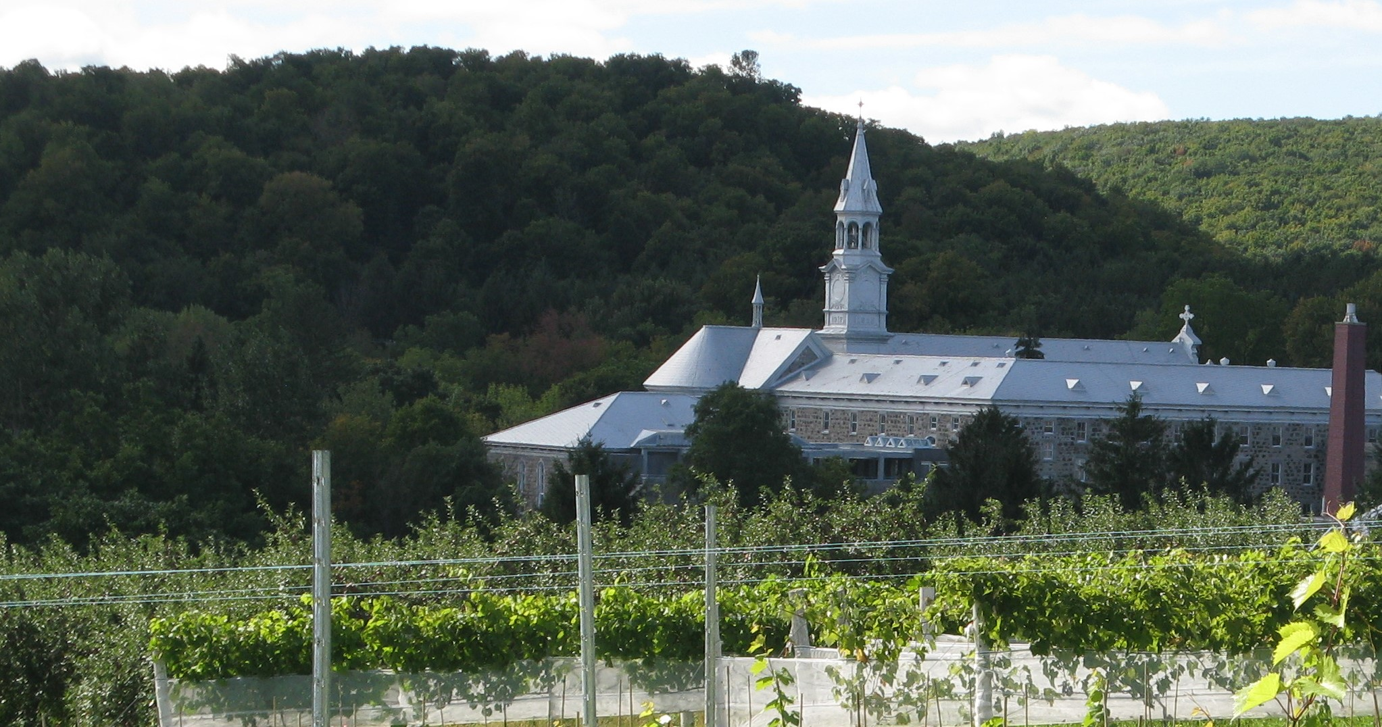





Acknowledgments
Thanks to the members of the cultivar trial committee and specifically Gaelle Dubé for her help with research
Funding for this project is currently provided by the Ministère de l’Agriculture, des Pêcheries et de l’Alimentation Financial support is also provided by the Conseil des vins du Québec.

