Slide 1
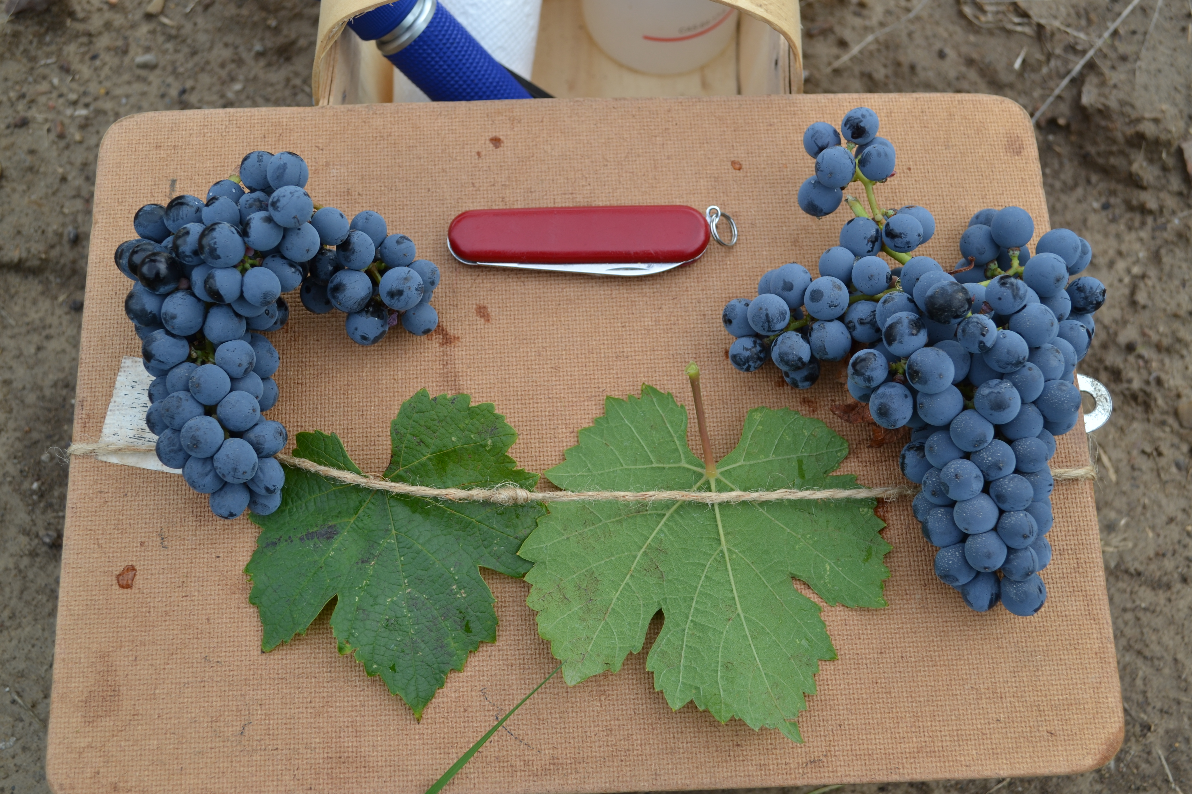
New varieties for what climate?
K. H. Fisher
University of Guelph

Slide 2

Why do we need new varieties?
What’s wrong with the ~20 cultivars that dominate the world wine market today?
  Are diseases becoming more common and/or more severe with potential climate change?
  Are diseases becoming more severe because of monoculture, closely related varieties/clones?
  Are we too dependent on fungicides?
  Do we need to build in heat/drought/flood tolerance?
  Do we need to build in spring frost/winter cold tolerance?
How do we create buffers to climate variability – in the variety or in the rootstock?

Slide 3
How do we develop new materials?
Traditional crosses and then molecular aided screening:
  But – you need to know what you are looking for:
  Single gene resistance markers can be easily screened once you have identified their function - powdery mildew (several sources), downy mildew less successful
  Multiple gene resistances are far more difficult – drought tolerance, cold tolerance, abiotic tolerances in general – and need lengthy field trials for proof
  Good progress in pm and PD tolerance from outside vinifera, with high wine quality retained by vinifera backcrossing
Need more work to define the multi-gene parameters
Need better rootstocks for drought and salt tolerance
Good progress in new wine selections while maintaining 95-98% vinifera for fruit quality and consumer acceptance

Slide 4
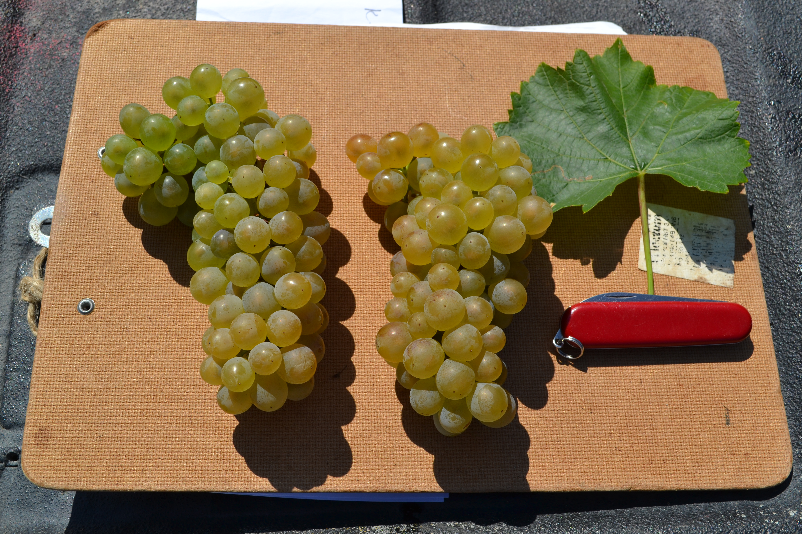
Where are new varieties coming from?
Germany
  Freiburg
  Geilweilerhof (JKI)
  Geisenheim
Italy
  Udine
  Rauscedo (rootstocks)
Switzerland
  Blattner
  Changins
France
  INRA
United States
  New York/Geneva
  UCDavis (Varieties and rootstock)
  UGeorgia (Muscadines)
  UArkansas (table grapes)
  USDA/CA (raisin grapes)
  USDA/NY (rootstocks)
Chile
China
Hungary
Czechia

